Slide 1
How Much of the Internet Is Fake? Turns out a Lot, Actually.
Original Article BY: Max ReAd, New York Magazine, 2018
Presented By: Matthew Stevenson
CS895 – Spring 2019
Source: http://nymag.com/intelligencer/2018/12/how-much-of-the-internet-is-fake.html

Slide 2
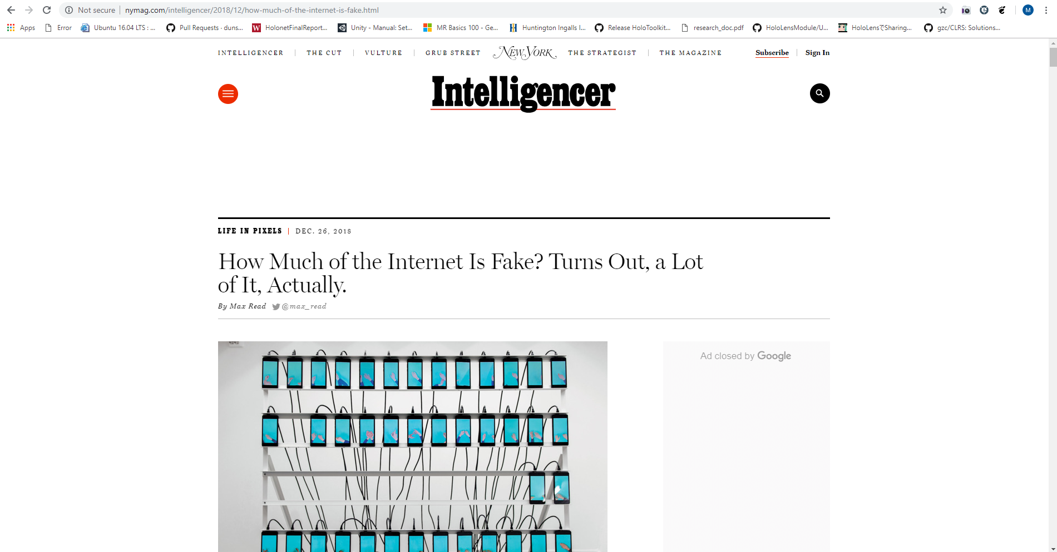
Source: http://nymag.com/intelligencer/2018/12/how-much-of-the-internet-is-fake.html

Slide 3
At first glance of the article title, that raises some serious questions.
Let’s look at an example…

Slide 4
Example of a Counterfeit Site
Source: https://services.google.com/fh/files/blogs/3ve_google_whiteops_whitepaper_final_nov_2018.pdf

Slide 5
“Studies generally suggest that, year after year, less than 60 percent of web traffic is human; some years, according to some researchers, a healthy majority of it is bot.”
- Max Read
Source: http://nymag.com/intelligencer/2018/12/how-much-of-the-internet-is-fake.html

Slide 6


Is the Internet only BotNets?
In late 2018, Digital ad fraud was recorded by the Justice Department in excess of $36 million dollars of damages due to 3ve technology and Methbot as the culprits.
Traffic was spoofed to appear that websites running ads were receiving “real” data by both 3ve and Methbot botnets.
The type of traffic includes:
Fake clicks
Mouse movements
Social network login information appear to be a real user
Source: http://nymag.com/intelligencer/2018/12/how-much-of-the-internet-is-fake.html

Slide 7
3ve Technology

Slide 8

What is 3ve technology?
“3ve (pronounced “Eve”) was a global, complex family of online fraud operations, each designed to evade detection.” – White Ops
Source: https://www.whiteops.com/3ve

Slide 9
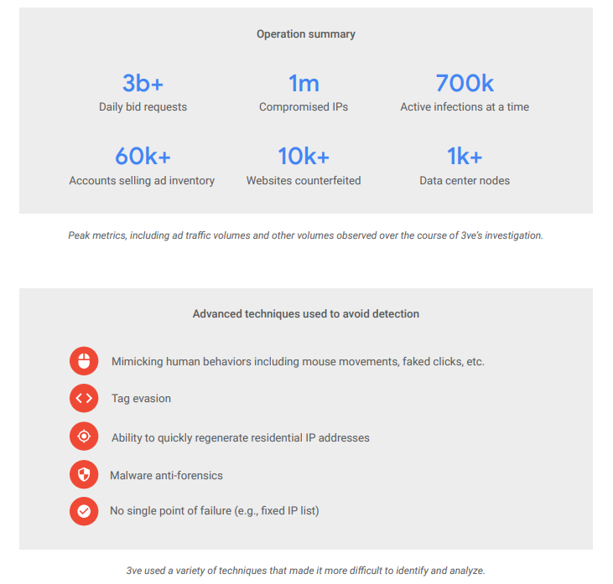
Effects of 3ve
Source: https://services.google.com/fh/files/blogs/3ve_google_whiteops_whitepaper_final_nov_2018.pdf

Slide 10
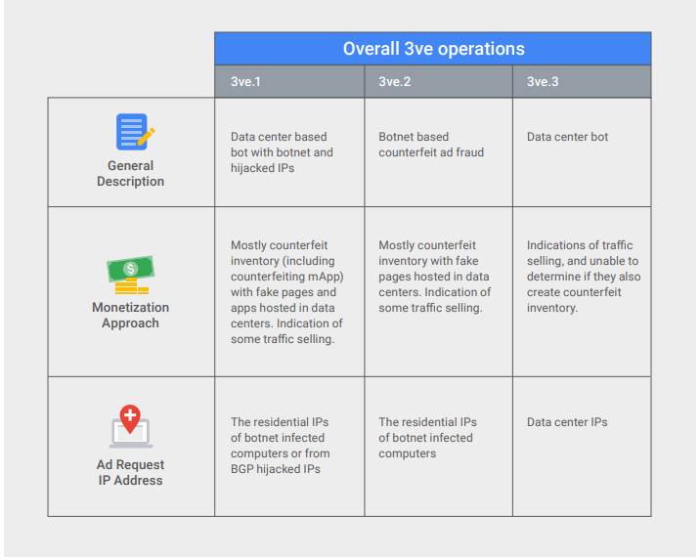
Source: https://services.google.com/fh/files/blogs/3ve_google_whiteops_whitepaper_final_nov_2018.pdf

Slide 11
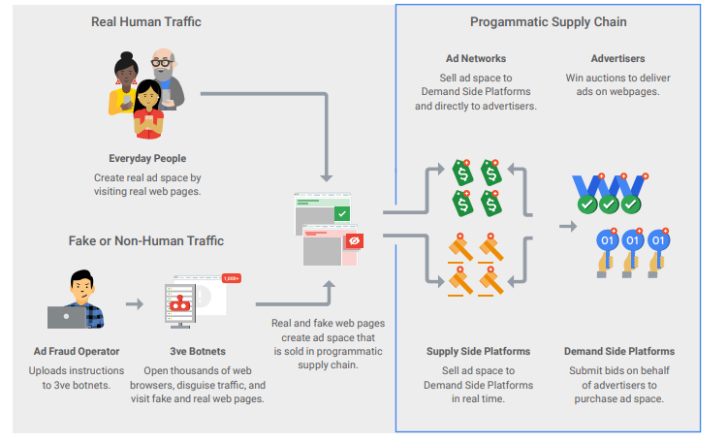
Source: https://services.google.com/fh/files/blogs/3ve_google_whiteops_whitepaper_final_nov_2018.pdf

Slide 12
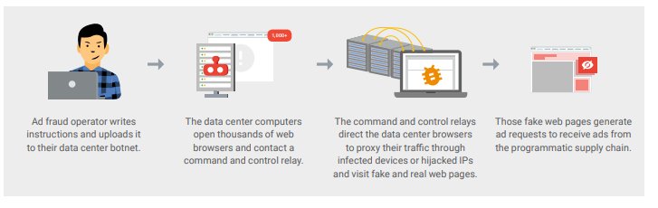
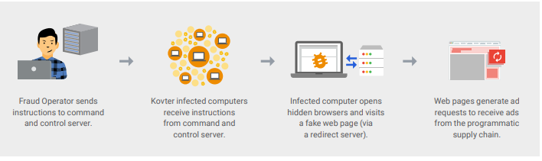
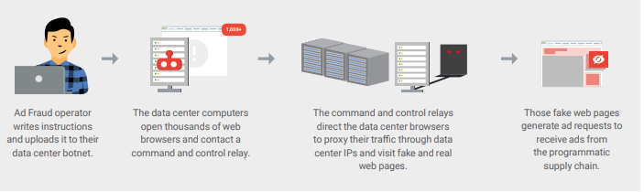
Architectures
3v1
3v2
3v3
Source: https://services.google.com/fh/files/blogs/3ve_google_whiteops_whitepaper_final_nov_2018.pdf

Slide 13
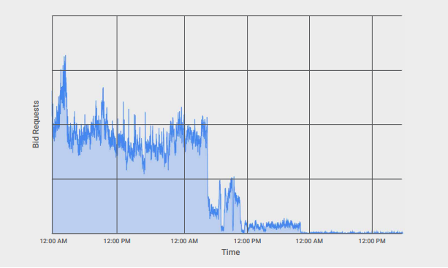
Incoming 3ve.2 Bid Requests (via OpenRTB Protocol)
Source: https://services.google.com/fh/files/blogs/3ve_google_whiteops_whitepaper_final_nov_2018.pdf

Slide 14
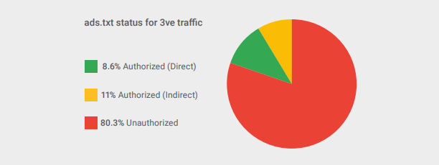
ads.txt Status for Recent 3ve Traffic
Source: https://services.google.com/fh/files/blogs/3ve_google_whiteops_whitepaper_final_nov_2018.pdf

Slide 15
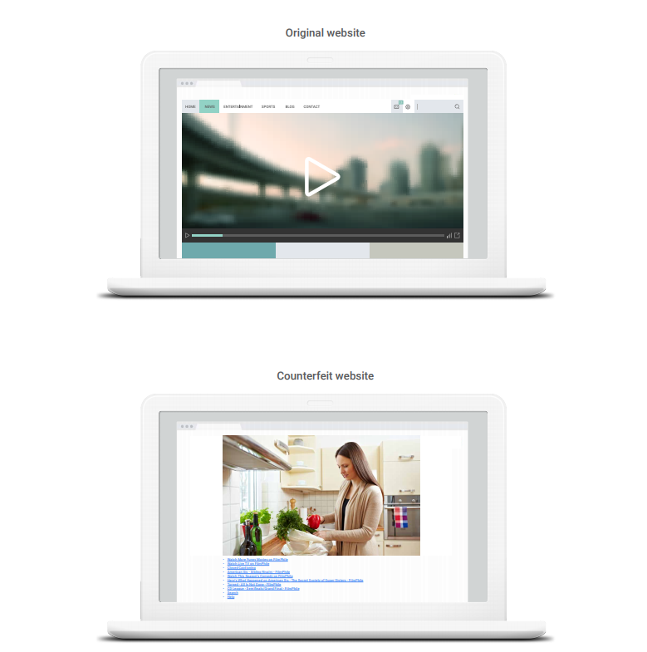
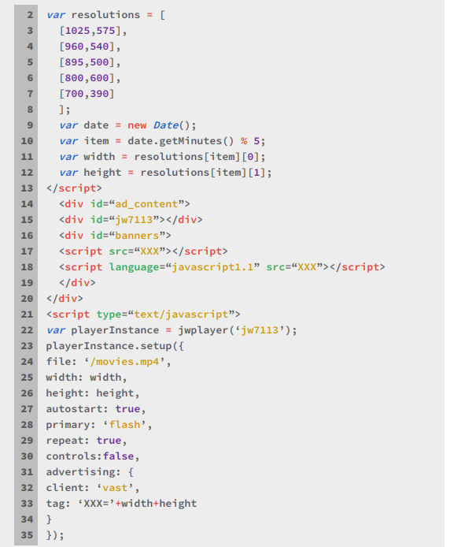
Fake website?
Source: https://services.google.com/fh/files/blogs/3ve_google_whiteops_whitepaper_final_nov_2018.pdf

Slide 16
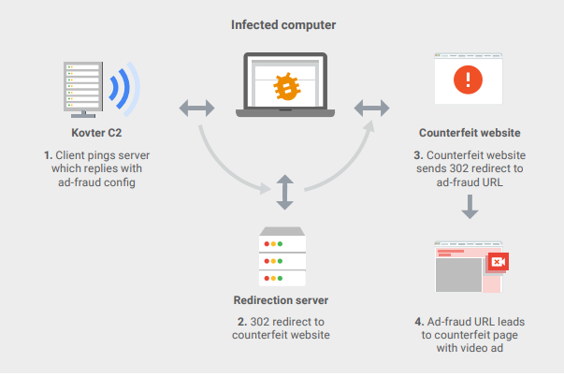
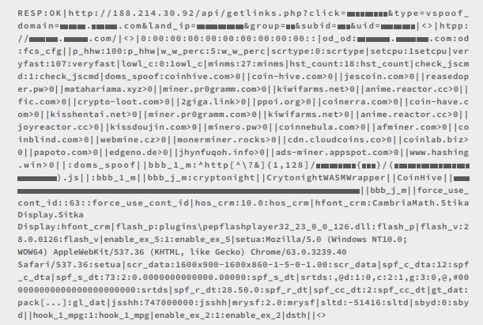
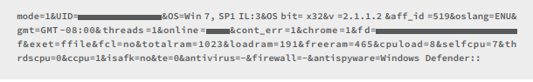
3v2 infected computer operations
Source: https://services.google.com/fh/files/blogs/3ve_google_whiteops_whitepaper_final_nov_2018.pdf

Slide 17
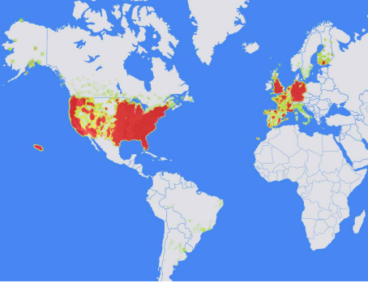
Area of Infiltration for 3v2
Source: https://services.google.com/fh/files/blogs/3ve_google_whiteops_whitepaper_final_nov_2018.pdf

Slide 18
Methbot

Slide 19
Effects of Methbot
Source: https://cdn2.hubspot.net/hubfs/3400937/WO_Methbot_Operation_WP_01.pdf

Slide 20
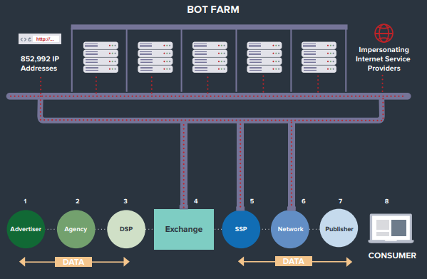
The Methbot Bot Farm
Source: https://cdn2.hubspot.net/hubfs/3400937/WO_Methbot_Operation_WP_01.pdf

Slide 21
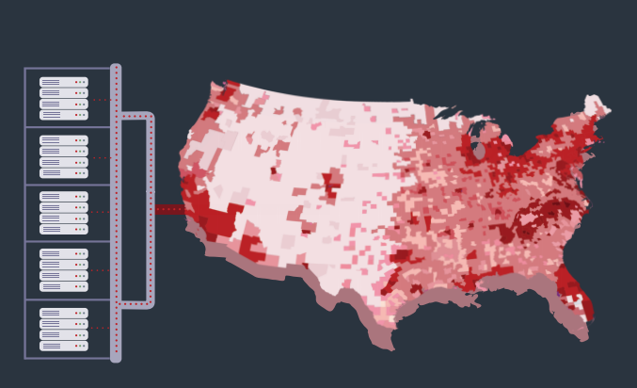
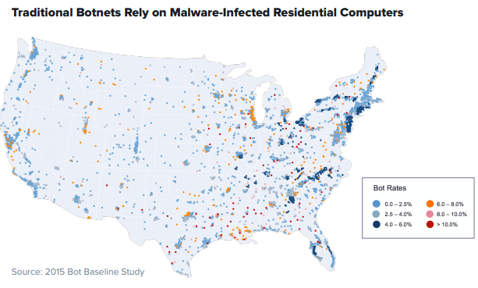
Heatmap Distribution of Methbot in Comparison to Traditional Botnets
Source: https://cdn2.hubspot.net/hubfs/3400937/WO_Methbot_Operation_WP_01.pdf

Slide 22

Characteristics of Methbot
Preserve session data between executions
Parse html
Uses JWPlayer to run ad tags and request video advertisements
NodeJS
Source: https://cdn2.hubspot.net/hubfs/3400937/WO_Methbot_Operation_WP_01.pdf

Slide 23
Key Behaviors
Counterfeit pages
Offer Inventory
Produce Fake views and clicks
Source: https://cdn2.hubspot.net/hubfs/3400937/WO_Methbot_Operation_WP_01.pdf

Slide 24
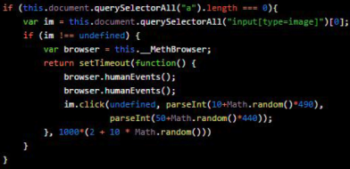
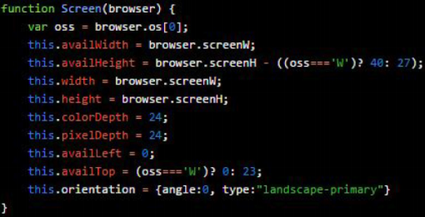
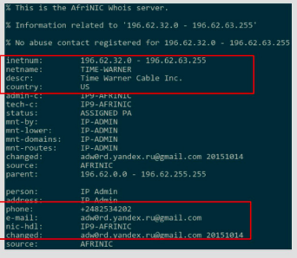
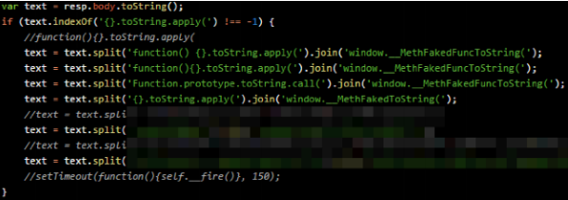
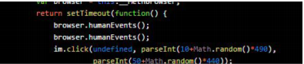
Avoidance of Fraud Detection
Screen object construction
Dynamic Code Patching
Spoofing Behaviors
Human Input Simulation
Forged IP Registration
Source: https://cdn2.hubspot.net/hubfs/3400937/WO_Methbot_Operation_WP_01.pdf

Slide 25
Why Should We Be Concerned?

Slide 26
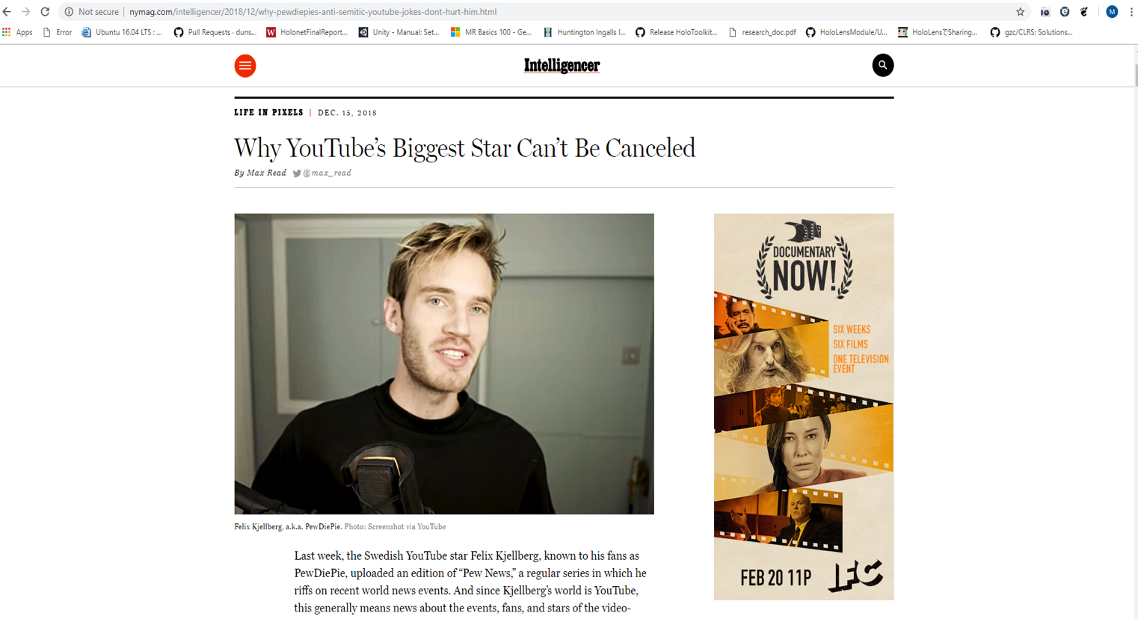
PewDiePie?
Source: http://nymag.com/intelligencer/2018/12/why-pewdiepies-anti-semitic-youtube-jokes-dont-hurt-him.html

Slide 27
‘They called this hypothetical event “The Inversion.”’
the internet is highly saturated with botnet traffic.
machine learning algorithms are evolving based off large amounts of botnet traffic.
increased botnet traffic saturates the ability to correctly detect real vs fake activity
humans could become outliers
Source: http://nymag.com/intelligencer/2018/12/how-much-of-the-internet-is-fake.html

Slide 28
How serious is the problem?
Answer:
Very serious. Let’s take a look at some examples…

Slide 29
Where Are The Metrics?
Source: https://www.wsj.com/articles/advertisers-allege-facebook-failed-to-disclose-key-metric-error-for-more-than-a-year-1539720524

Slide 30
Fake People?
Source: https://twitter.com/mbrennanchina/status/1072114511212109824

Slide 31
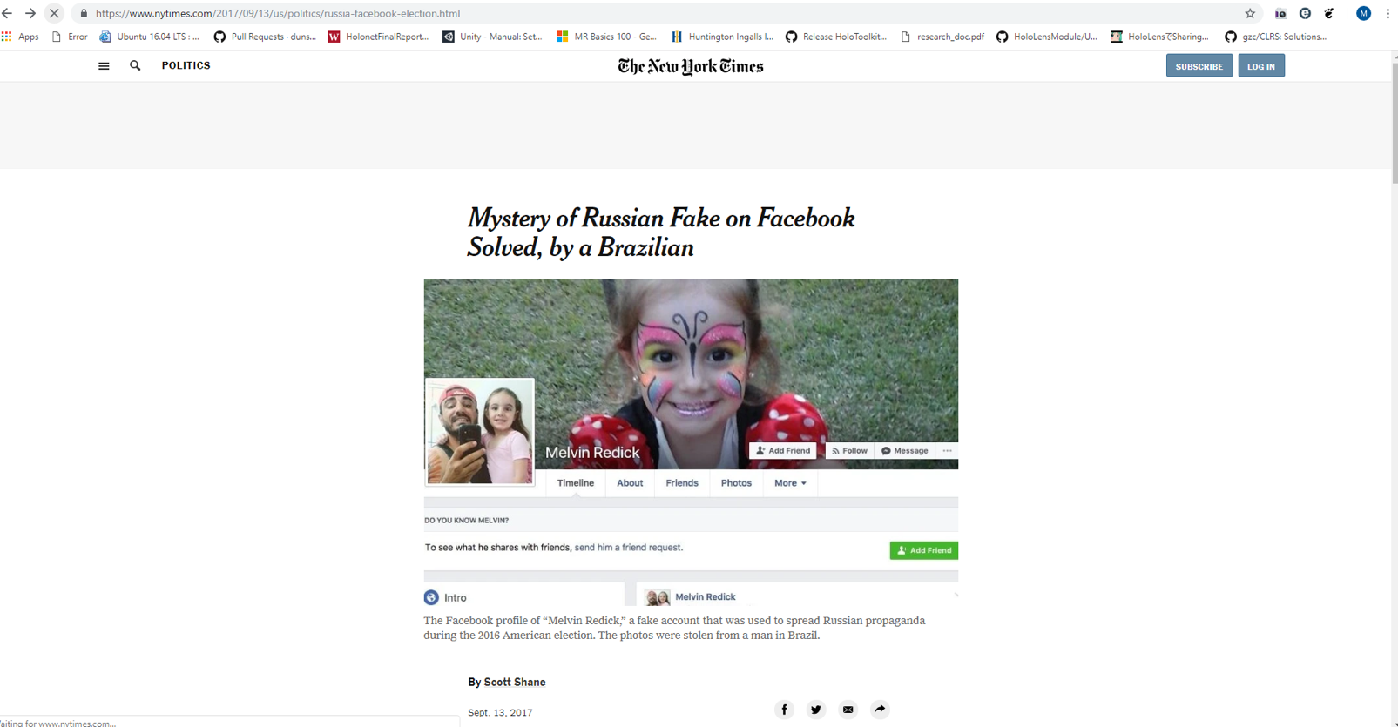
Source: https://www.nytimes.com/2017/09/13/us/politics/russia-facebook-election.html

Slide 32
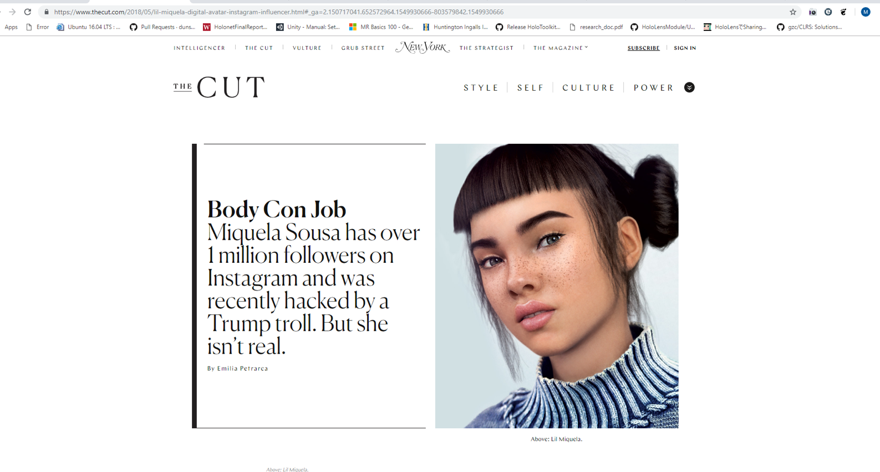
Source: https://www.nytimes.com/2017/09/13/us/politics/russia-facebook-election.html

Slide 33
Fake Businesses?
Source: https://www.nytimes.com/interactive/2018/11/27/style/what-is-inside-this-internet-rabbit-hole.html

Slide 34
Fake Content?
Source: http://nymag.com/intelligencer/2018/08/what-is-the-baby-meme-about-eating-sugar-and-telling-lies.html

Slide 35

Fake Politics?
“Drown out” opposing viewpoints
Sway public opinion

Slide 36

What does this mean for us as a “real” person?
Answer:
The odds grow increasingly not in our favor.

Slide 37
Closing Remarks
at some point We must prove:
We Are “Not a bot”
What is Real VS Fake

